Slide 1
Welcome to
Oracle Week 2024
we will start
in a few minutes

Slide 2
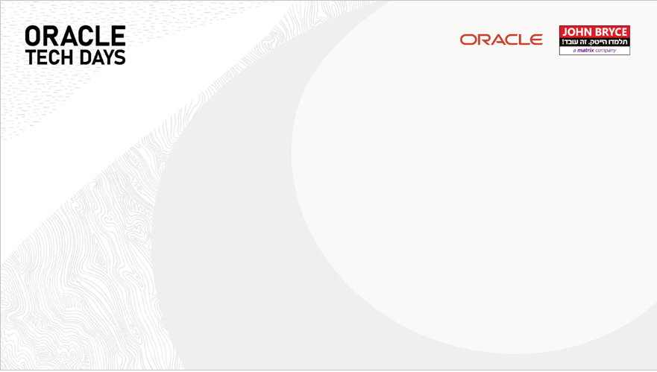
Microfrontends
Gal Amouyal

Slide 3
Introduction
galamouyal88@gmail.com
Github: galamo

Slide 4

pnpm
Microservices
Vite
webpack
Notes:
הצגה עצמית.

Slide 5
Agenda
pnpm
Microservices
Vite
webpack

Slide 6
Agenda
Microfrontends
Framework
Host
Remote
Integrations types
State management

Slide 7
PNPM

Slide 8
PNPM
Stop reinstall packages
Faster
Single content-addressable storage
Strict structure – Non flat
Monorepos Support

Slide 9
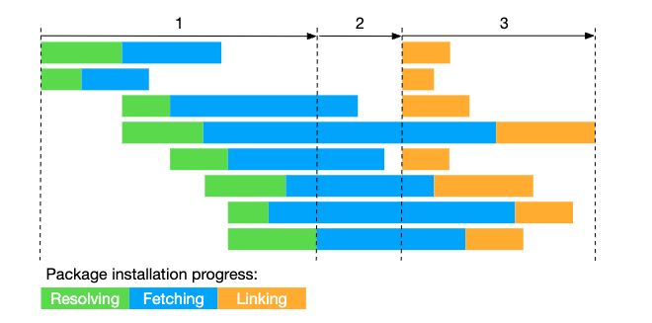
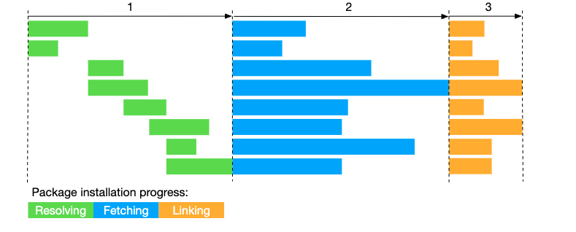
Faster

Slide 10
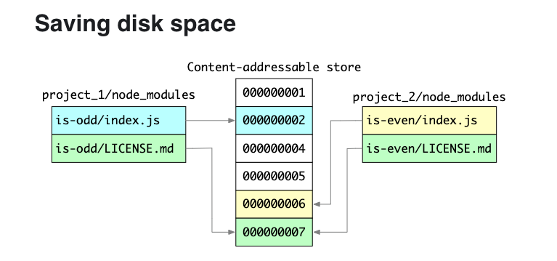
single content-addressable storage

Slide 11
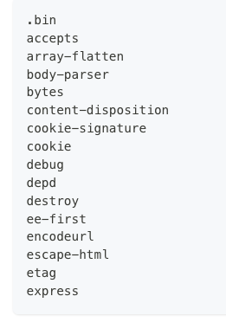
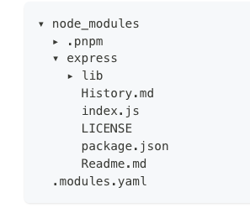
Non Flat structure
Flat structure

Slide 12
PNPM Example

Slide 13
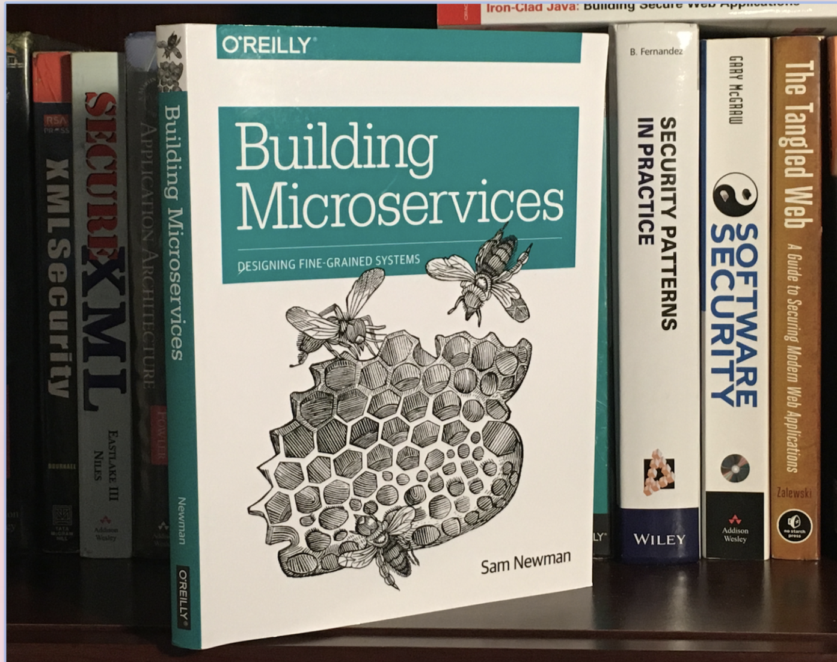
Microservices

Slide 14
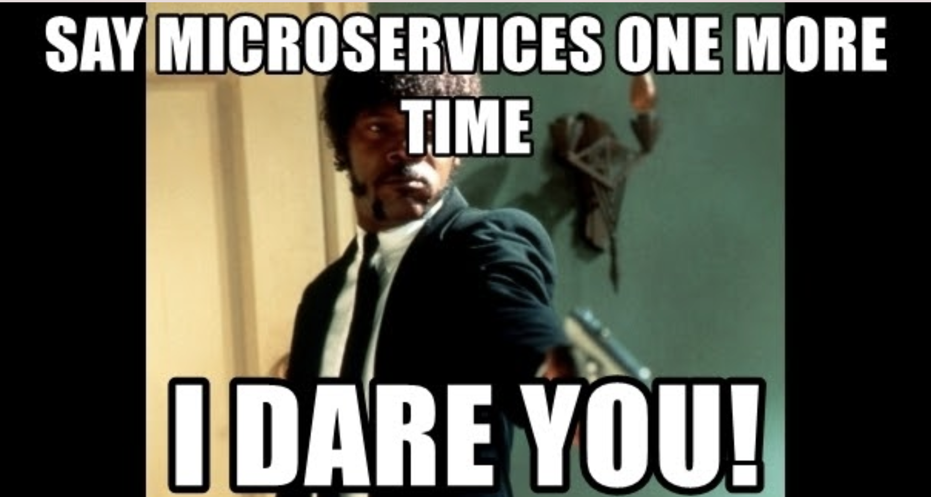
Facts
Code base always change
Progammers working in Teams
Creating good software architecture is hard

Slide 15
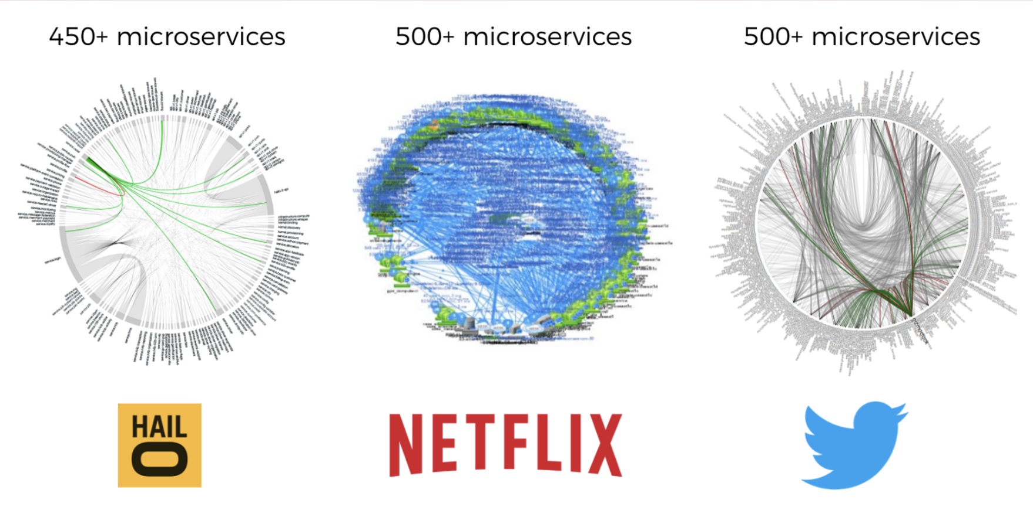

Slide 16
“Small and autonomous services that work together and model around a business domain” Sam Newman

Slide 17
What Are They?
Small services
Build around business capabilities
Running int its own process
Minimum of centerlized management
Low coupling – independent
High cohesion – single well-defined purpose , code together.

Slide 18
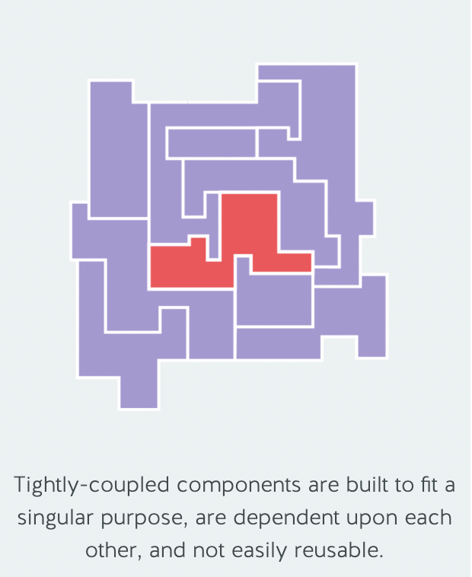
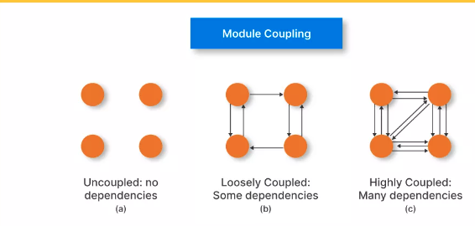
Tight Coupling
Tight Coupling is the idea of binding resources to specific purposes and functions. Tightly-coupled components

Slide 19
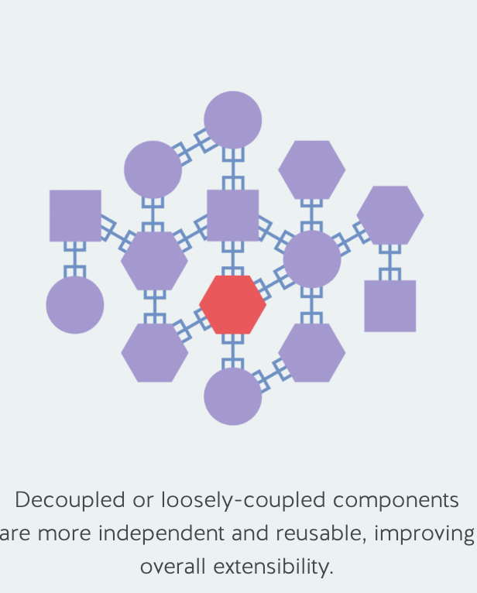
Loose Coupling
Loose Coupling, however, is the opposite paradigm. In a loosely coupled system, the components are detached from each other. Every resource could have multiple frontends or applications

Slide 20
Microservices benefits
Easier to maintain
Organized around a business domain
Improving development speed
Flexibility on choosing technologies
Autonomous teams
Scale-out

Slide 21

Easier to maintain

Slide 22
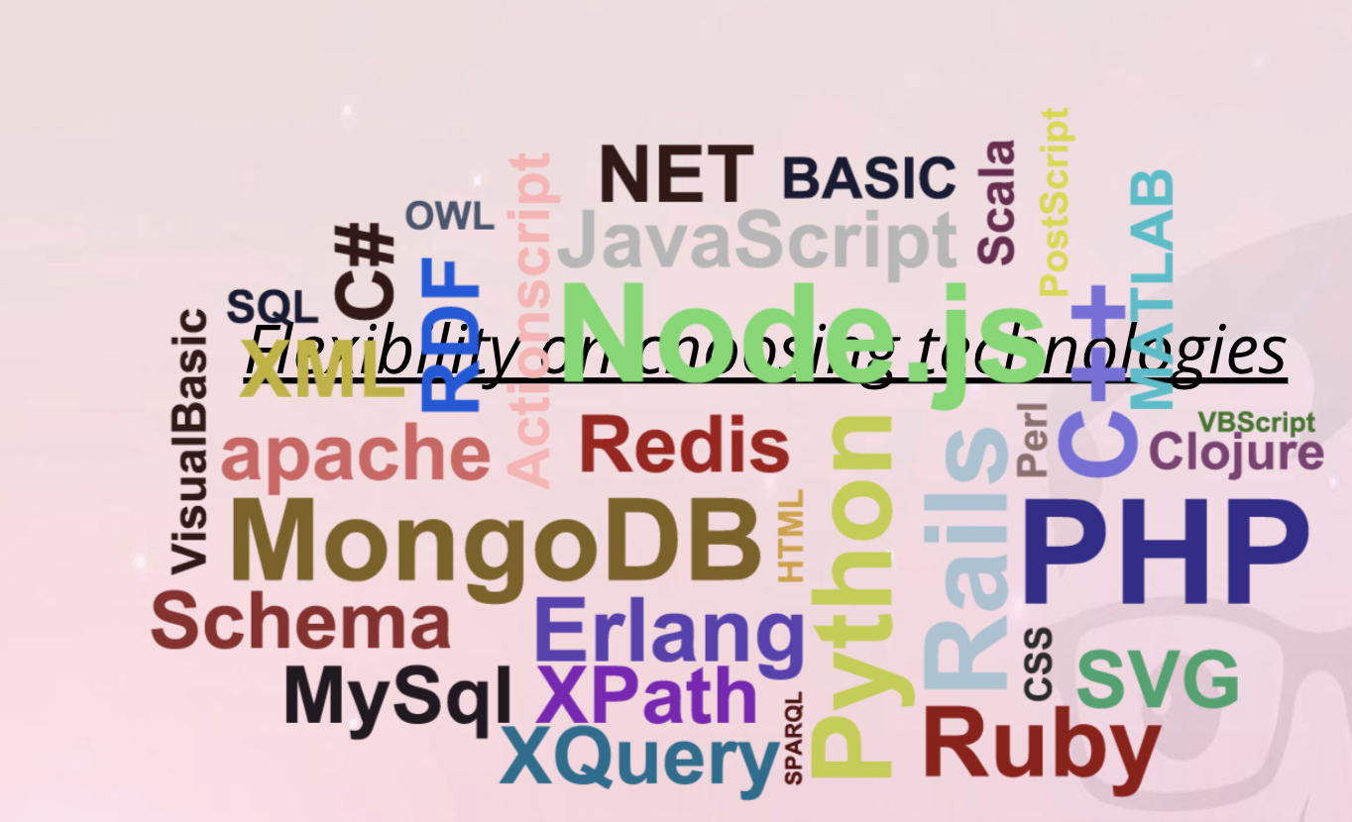
Flexibale

Slide 23

Scale out

Slide 24
Chanllenges in Microservices
Service communication
Data management
Operational overhead
Latency
Resilience
Monitoring

Slide 25
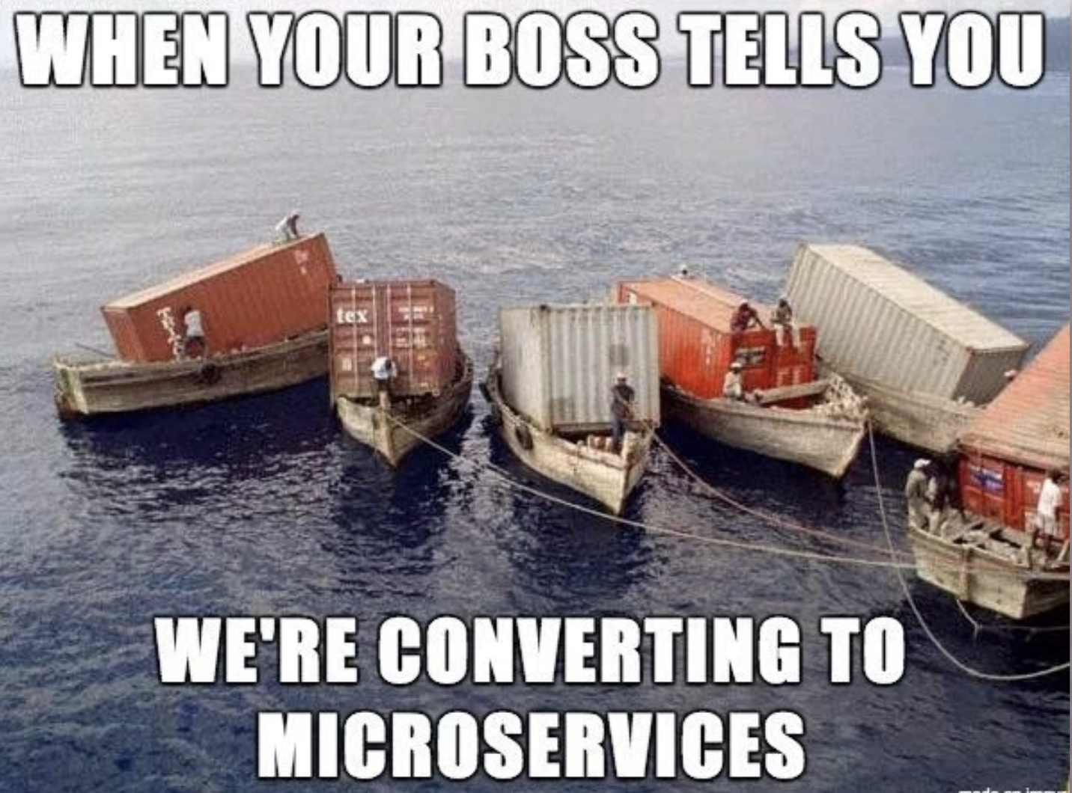

Slide 26
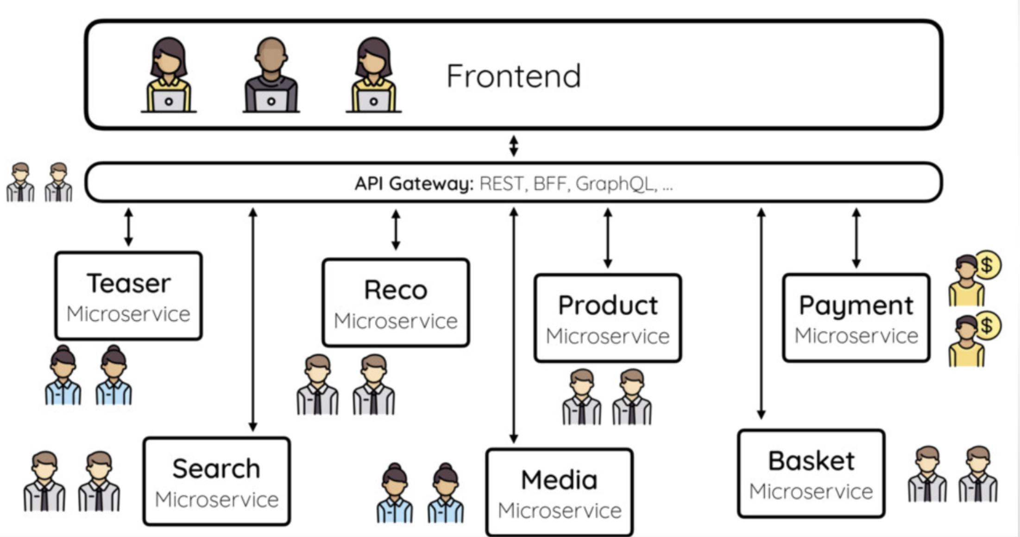

Slide 27
Microservices Communication
Over HTTP
Event Bus
Message Queue

Slide 28
What are Microfrontends ?

Slide 29
Example

Slide 30
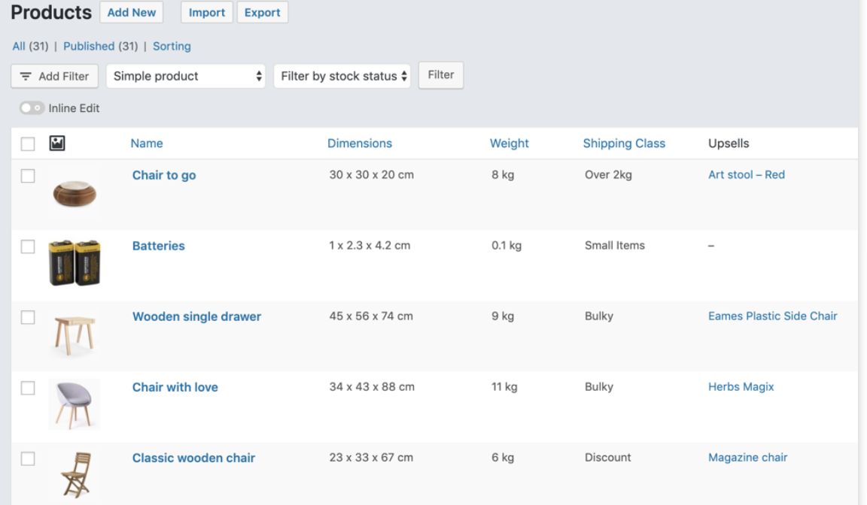
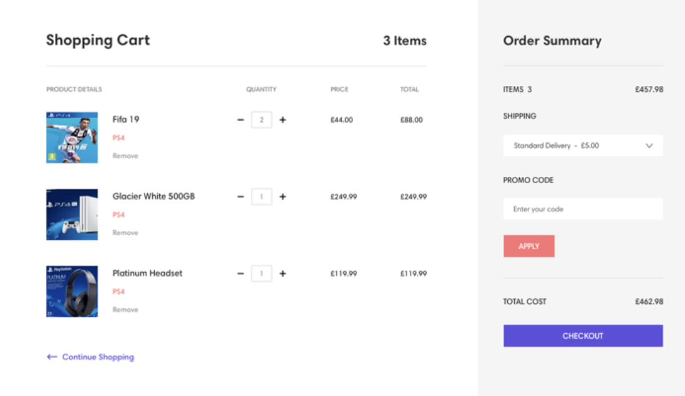
Lets Build Ecommerce Application
ProductList
ShoppingCart

Slide 31
Monolithic Single Page Application
ProductList
ShoppingCart

Slide 32
Angular/React/View
ProductList
ShoppingCart

Slide 33
Move to MF’s

Slide 34
Distinct major features

Slide 35
Separate each one of them to own code base
Feature 1
Feature 2

Slide 36
React/Angular/Vue
React/Angular/Vue

Slide 37
React/Angular/Vue
React/Angular/Vue
Product List Api
Shopping Cart Api

Slide 38
React/Angular/Vue
React/Angular/Vue
Product List Api
Shopping Cart Api

Slide 39
MF’s – What are they?
Dividing a monoloth into small apps
Each App responsible on specific feature ( domain )

Slide 40
MF’s – Why use them?
Multiple teams & isolation
Small Apps/Base code is more clear and better to understand
Isolated apps = isolated changes = isolated problems ( bugs )
Multiple Frontend technologies

Slide 41
Container
Container needs to access the MF’s
Orchestrating MF’s

Slide 42
Container
React/Angular/Vue
React/Angular/Vue

Slide 43
Container
When and where to show each Microfrontend
React/Angular/Vue
React/Angular/Vue

Slide 44
MF’s Integrations
Build time integration ( Before container loaded in the browser)
Run time integration ( After the container is loaded in the browser )
Server side integration ( When sending the static content to the client)

Slide 45
Build time integration
Developing ProductList
Building, Testing
Publishing Product list as NPM package ( using npm registry )
Devloping Container - install the new ProductList
Output bundle includes all the code ( Container & ProductList)
Summary: the Container access the MF’s before the code is loaded in the browser

Slide 46
Build time integration
Easy to setup & understand
We must deploy the Container every time we want to get the updated ProductList.
Tempting tightly couple the Container and the ProductList together

Slide 47
Example
Create lib
Publish
Use the Component

Slide 48
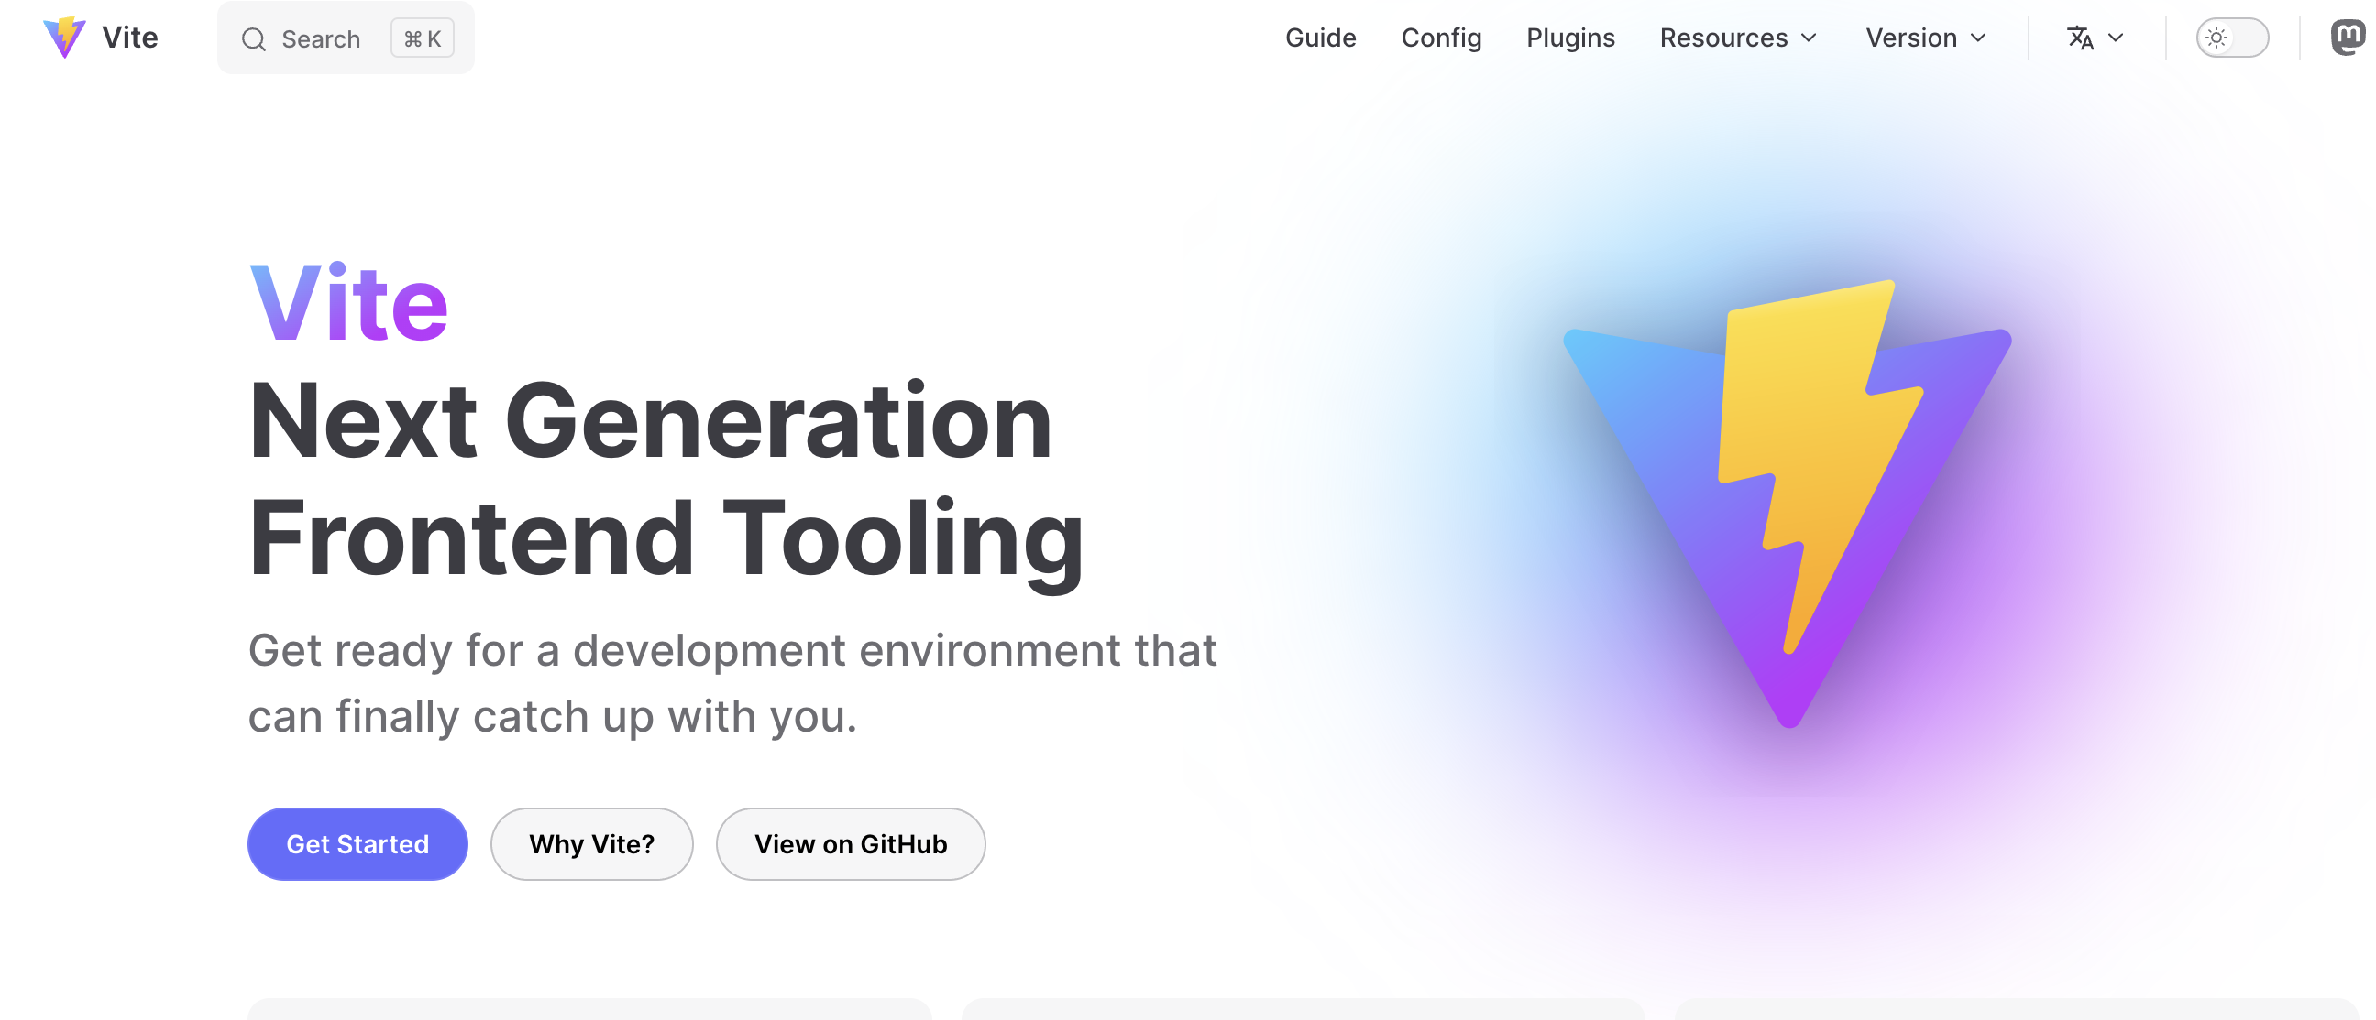
Use vite

Slide 49
Vite
Lightning-Fast Development Server
Native ES Modules Support
Blazing-Fast Production Builds
Zero Configuration
Devtool Integration
Plugin Ecosystem

Slide 50
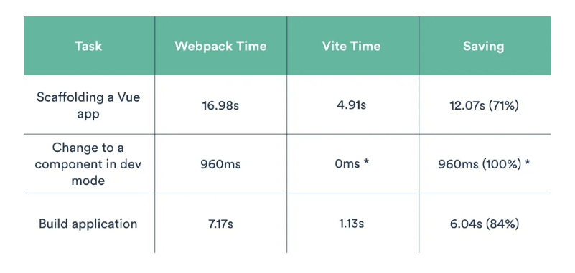
Vite

Slide 51
Run time integration
Developing ProductList
Building, Testing
Code deployed at https://my-mfs-app/productList.js
User Naviage in the Container app to https://container
Container App fetch ProductList and run it
Output bundle includes Container code only ( fetch the ProductList )

Slide 52
Run time integration
ProductList can be deployed intependetly at any time
Container can decide which ProductList version to use in run time
Tooling and setup more complicated

Slide 53
Distinction
Build time
Run time
after application is loaded in the browser
before application is loaded in the browser

Slide 54
Runtime integration
Only looks like hard setup
Flexibale and performant solution
Based on ModuleFederation
No TS support

Slide 55
Why?

Slide 56

Team scalability

Slide 57
Independent deployment

Slide 58
Strategy and tactical focus

Slide 59
Technology agnosticisim

Slide 60
Why Not?

Slide 61
Complexity ?

Slide 62
Unexpected run time issues

Slide 63
No standart approach

Slide 64
MF’s patterns

Slide 65
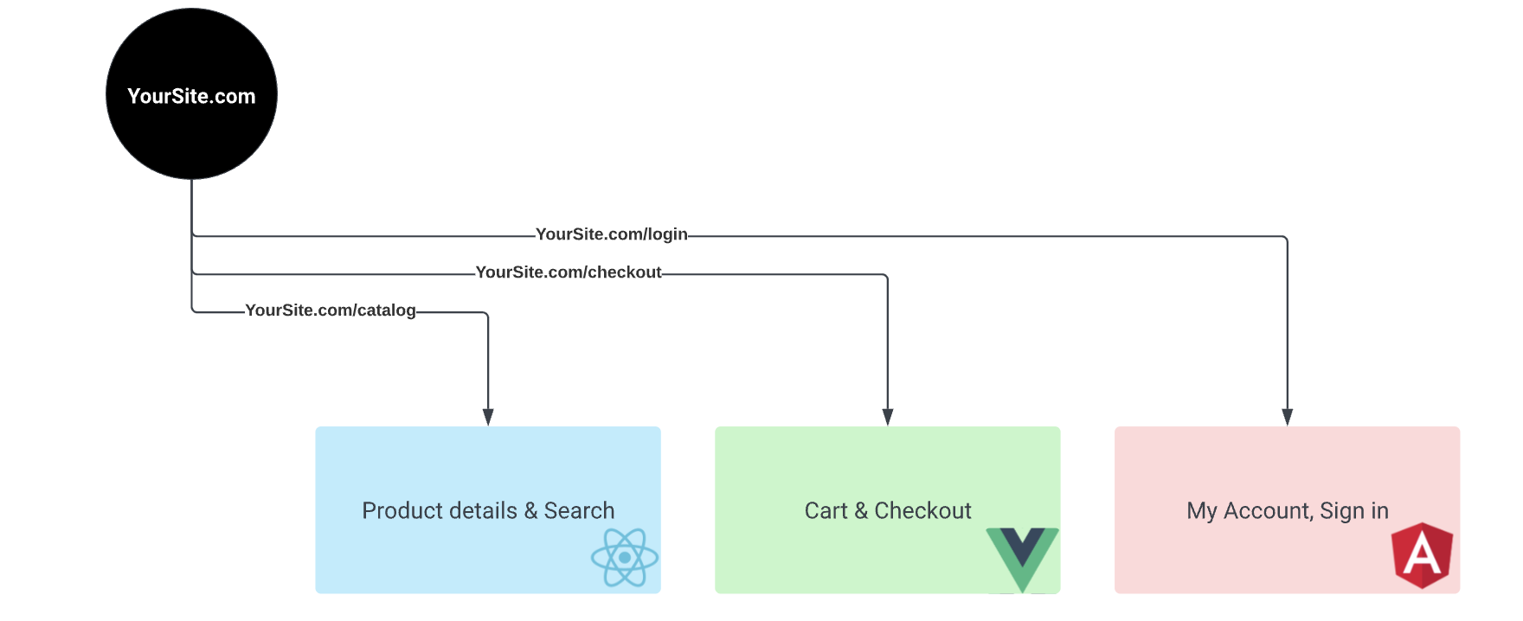
Multi SPA

Slide 66
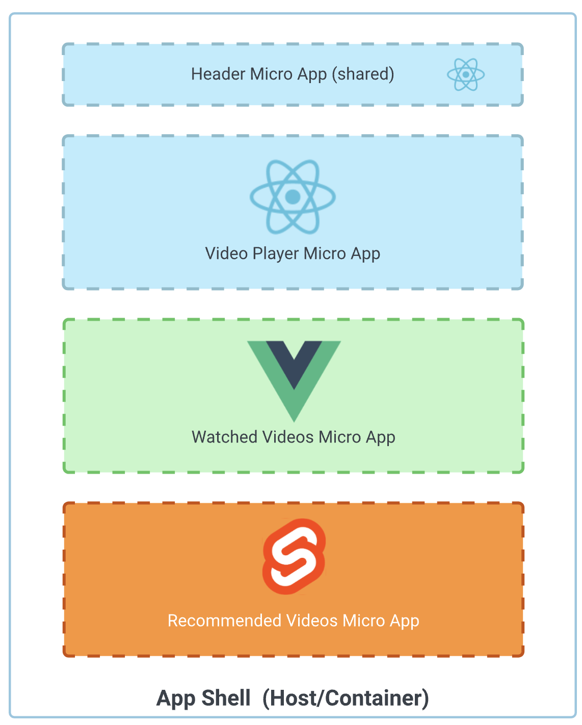
Micro App

Slide 67
React Code splitting
Lazy loading
Suspense

Slide 68
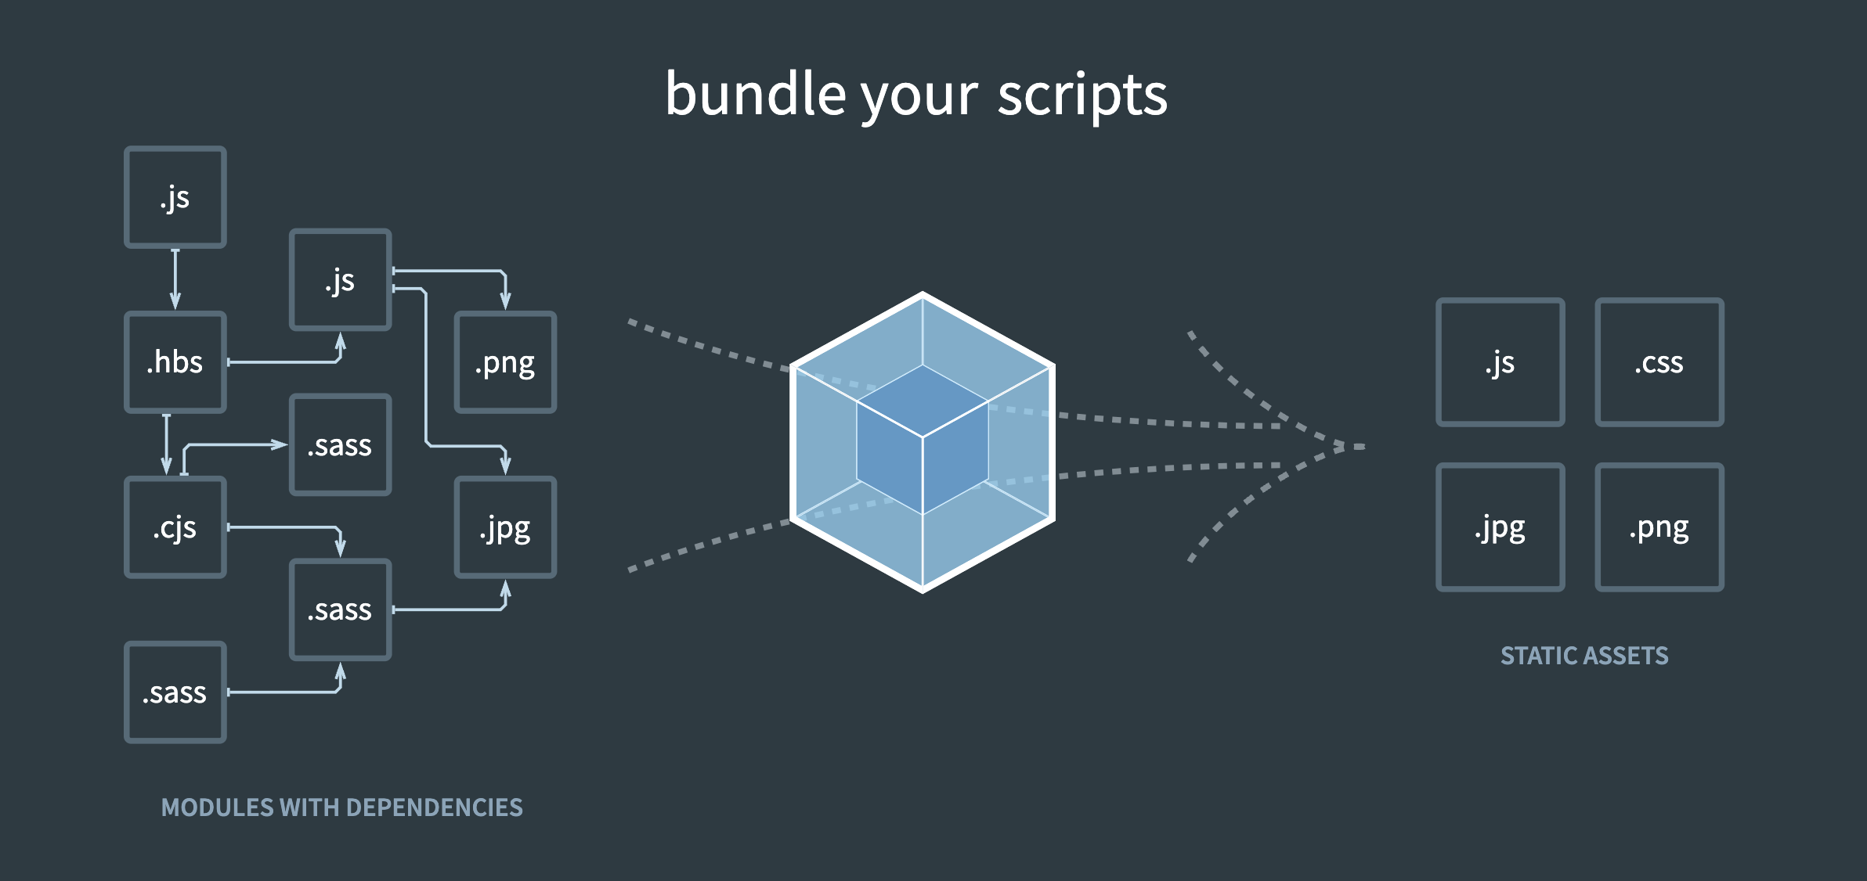
Webpack

Slide 69
Webpack
Webpack.config.js
Webpack command ( cli )
Dist folder as output for one or few bundles

Slide 70
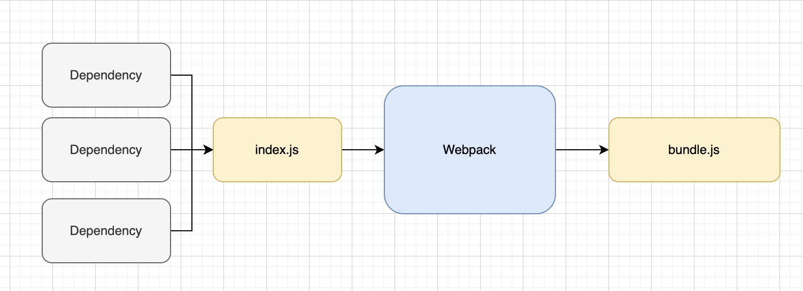
Webpack

Slide 71
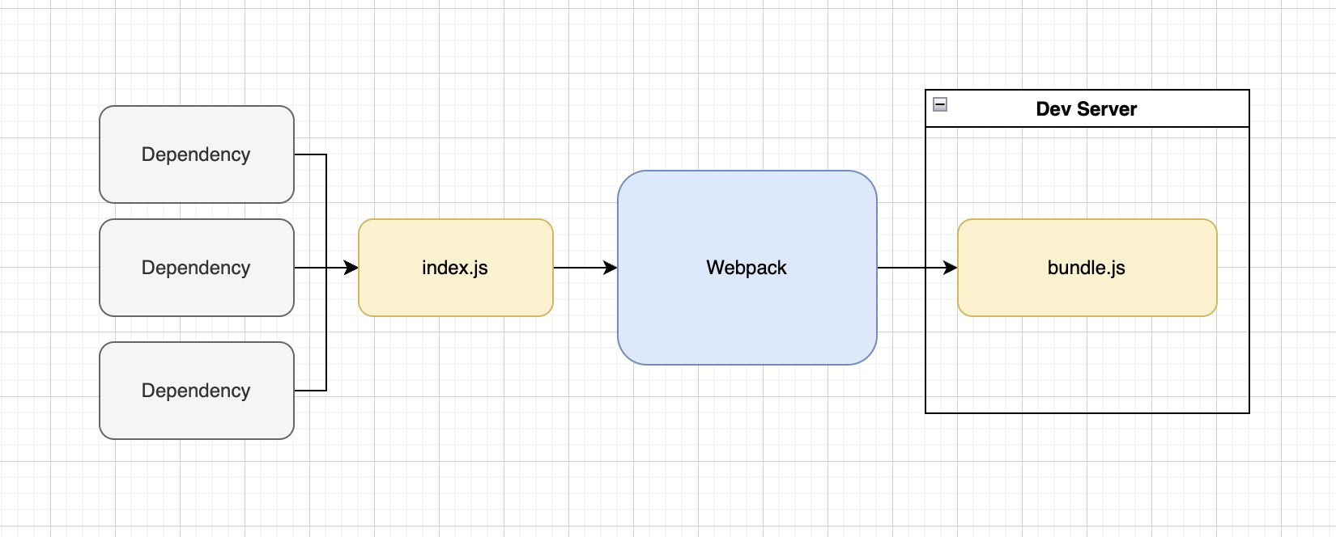
Webpack dev server
Puts webpack output avilable in browser

Slide 72
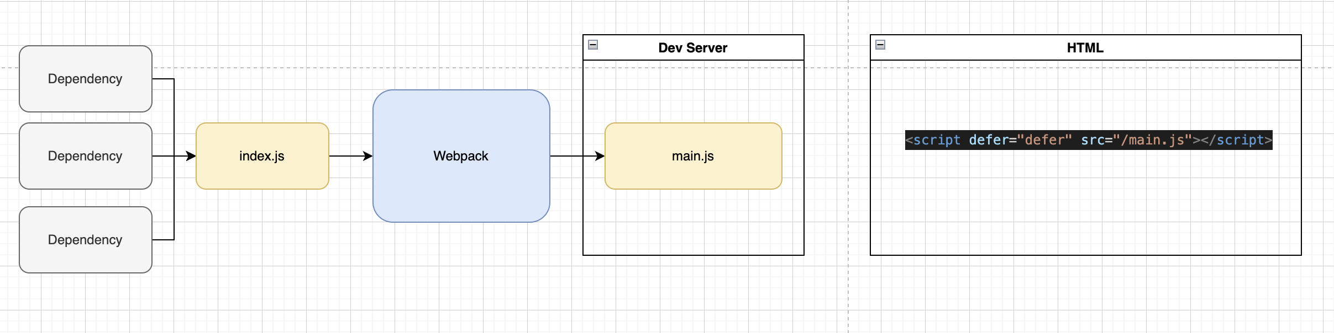
Webpack

Slide 73
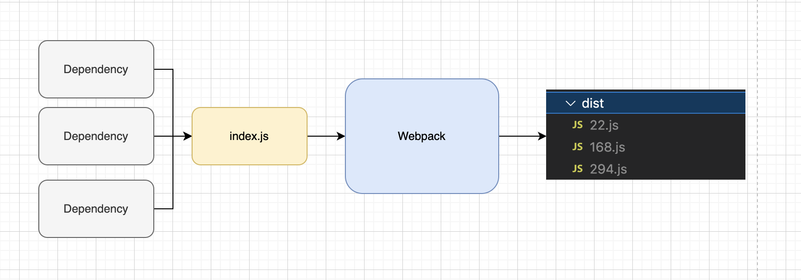
Webpack Output

Slide 74
HtmlWebPackPlugin
Takes generated files from webpack
Plant them inside the HTML as static script tag

Slide 75
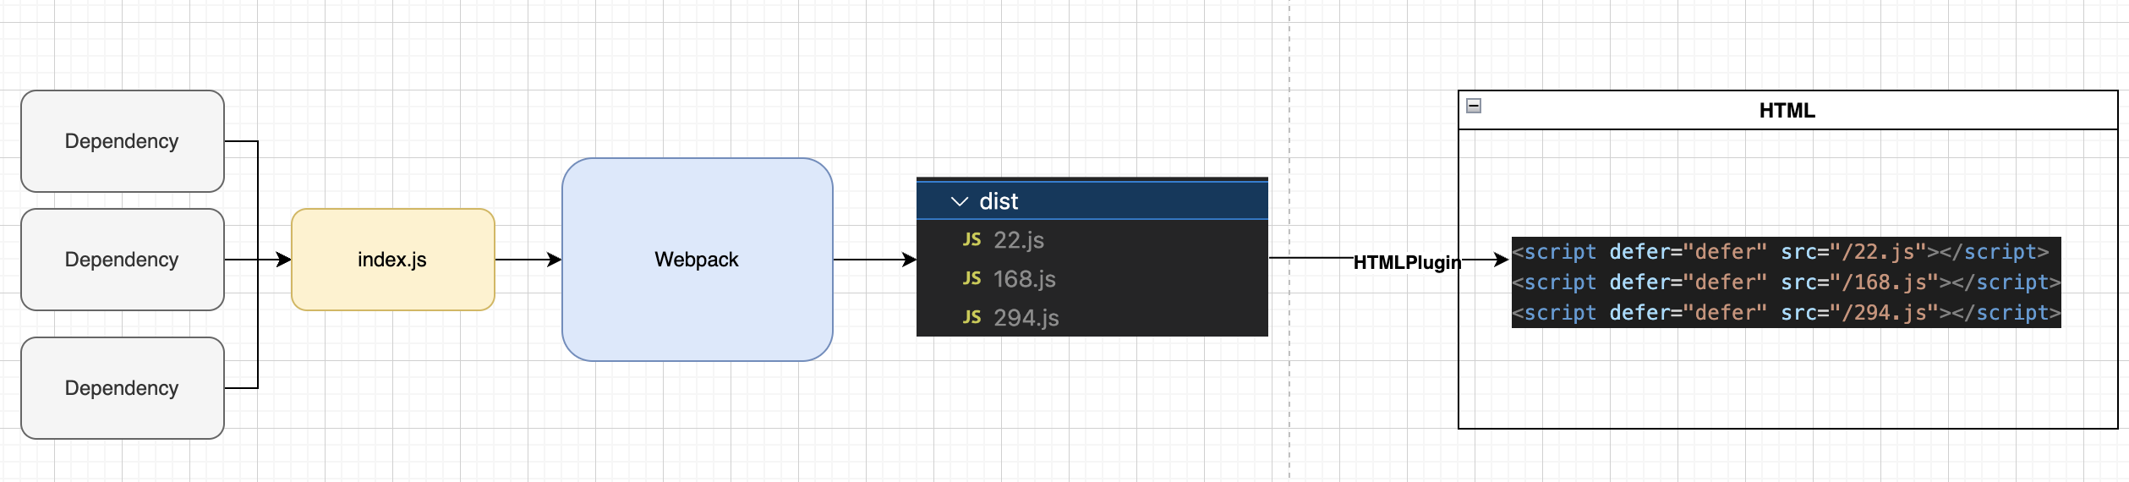
HtmlWebPackPlugin

Slide 76
ModuleFederationPlugin
Allows a build to provide or consume modules with other independent builds at runtime.

Slide 77
ModuleFederationPlugin
Host - Container App
Remote - Products / Cart App
Remote - Should expose modules and make them avilable to another projects
Remote - Setup module federation plugin to expose files
Host - Decide which files we want from the remote
Host - Setup module federation to fetch the files
Host - Import the relevant files

Slide 78
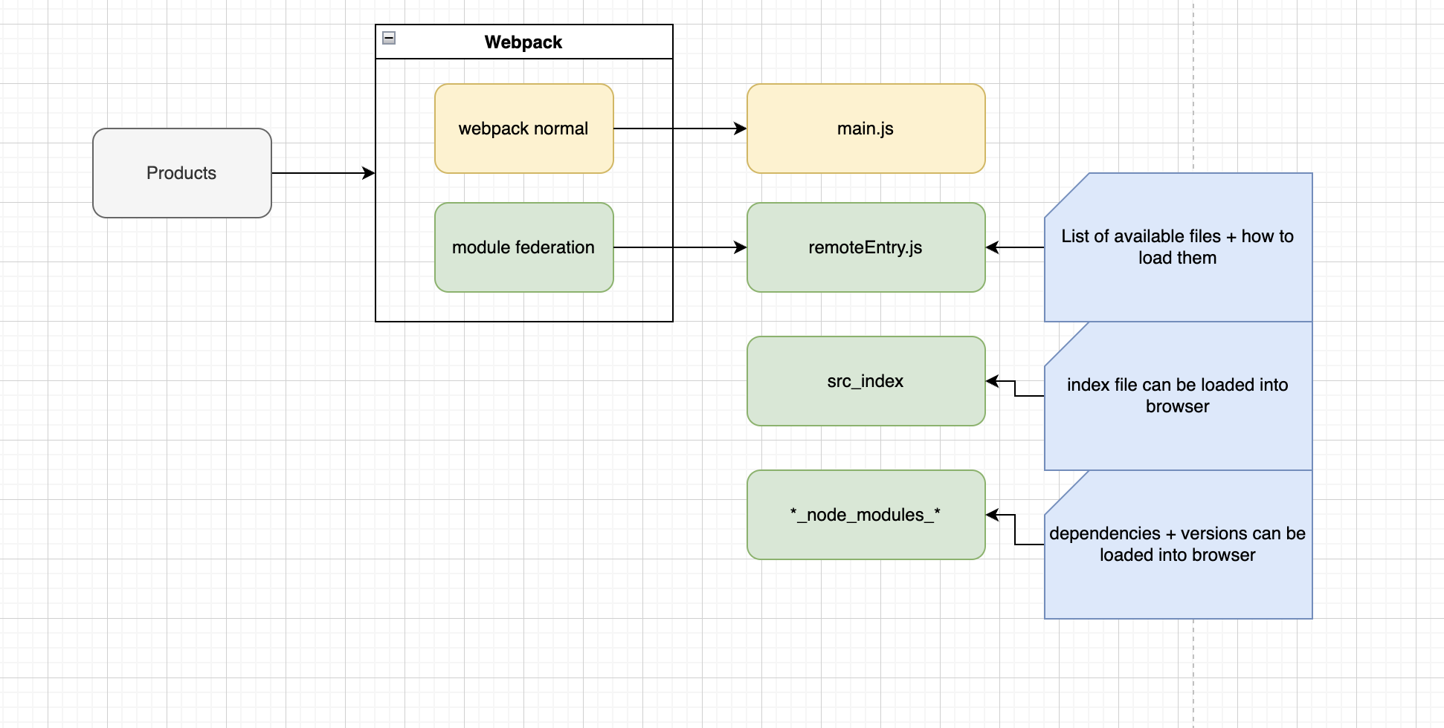
Network explained

Slide 79
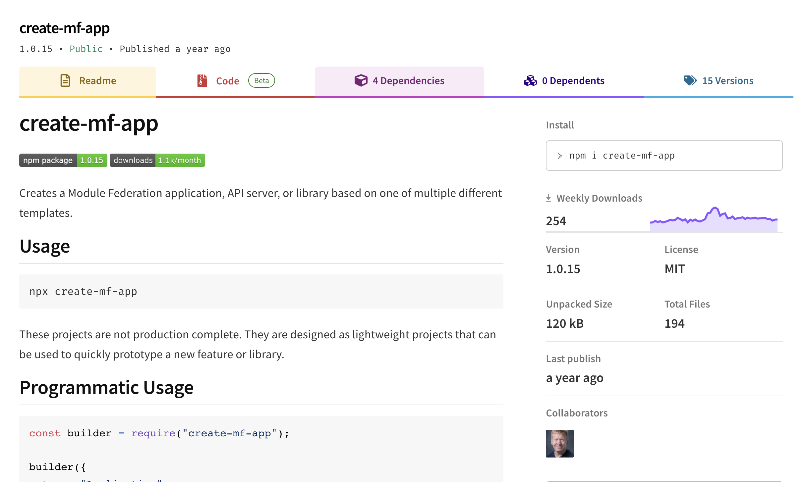
Create MF App
https://www.npmjs.com/package/create-mf-app

Slide 80
Shared modules
Remotes can load the same dependencies
Host will retrieve those dependencies twice
Shared
Singleton
Select a version

Slide 81
React
useDefferedValue
useTransition

Slide 82
Thank You

